Slide 1

Challenged Networks
Department of CSE, IUT

Slide 2
Delay Tolerant Network (DTN)
Core function of communication network -
Routing
Find a path from a source to some destination
Traditional routing solutions
Assume that there exists an end-to-end path between communicating nodes
Delay/disruption tolerant networks
Communication is possible even if end-to-end connectivity is never achievable
Exploiting node’s mobility
Using store-carry-forward fashion

Slide 3
Delay Tolerant Network (DTN)
A communications network designed to withstand long delays or outages. It is capable of storing packets in intermediate nodes until such time as an end-to-end route can be established.

Slide 4
DTN: How does it work?
destination
data
source
data
data
data
Traditional Routing

Slide 5
DTN: How does it work?
forward
store
data
carry
data
data
destination
source
DTN Routing

Slide 6

DTN: How does it work?
Bagel = Source
The bagel is the source of food
The ants carry the sugar or part of food taken from the bagel
The ants relay the sugar or food particle to the next ant
They carry the particle (not lost)
Destination can be their ant hill or location of their home
Ants = Relay

Slide 7
Challenges of DTN
Packet loss due to transmission errors
Frequent disconnections
limited communication bandwidth (common wireless challenge)
dynamic topology and routes
lack of mobility awareness by system/applications
short battery lifetime
limited capacity (memory and processing)

Slide 8
Applications of DTN
Loss of communication during disasters
Hurricanes, Tsunami, Earthquakes, etc.
Terrorist Attacks
Vehicular Networks
Interplanetary Communication
Interplanetary Network (IPN) launched by NASA initialized DTN in 1998 ^{[1]}
Wildlife monitoring
ZebraNet can be considered a DTN

Slide 9
Vehicular Ad Hoc Network (VANET)
A subclass of Mobile Ad Hoc Networks (MANET)
Devices are embedded in moving vehicles
Constrained by fast topology changes (high node mobility)
Wireless multi-hop network
Can connect to other networks (like WAN)
May have static RSU (Roadside Unit) to provide Internet

Slide 10
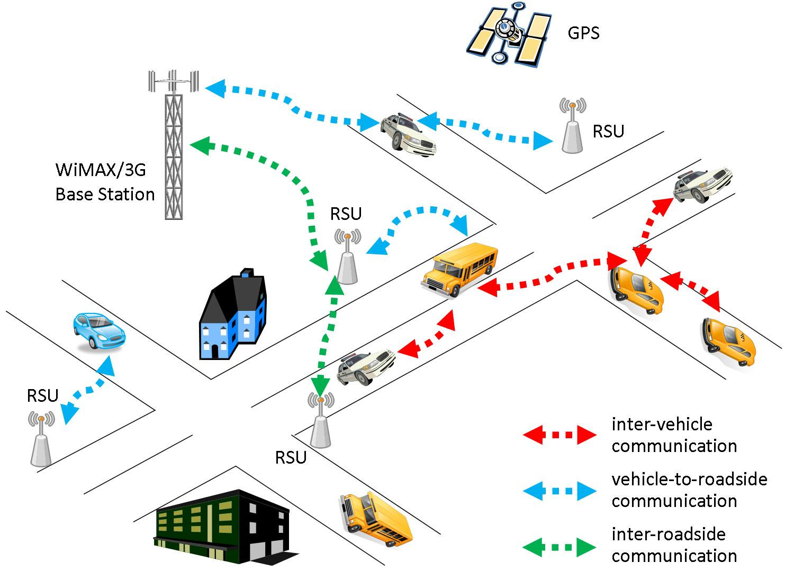
VANET: An Example Scenario

Slide 11
Issues and Challenges
Scalability – high density VANET leads to broadcast storm problems
Security and Trust – due to cooperative driving, security is often not considered in travel comfort applications
Quality of Service (QoS) – different applications have different QoS
Node Cooperation – VANET assumes cooperation but some maybe selfish
Simulation – difficult to simulate VANET due to various factors involved

Slide 12
References
[1] Burleigh S, Hooke A, Torgerson L, Fall K, Cerf V, Durst B, Scott K, Weiss H. Delay-tolerant networking: an approach to interplanetary internet. IEEE Communications Magazine. 2003 Jun 20;41(6):128-36.
[2] https://www.sciencedirect.com/topics/computer-science/vehicular-ad-hoc-network

